Slide 1

Computer Networks (CET2005B)
School of Computer Engineering and Technology (SCET)

Slide 2

Computer Networks
Teaching Scheme Credits: 3 + 1 = 4
Theory: 3 Hrs / Week Practical: 2 Hrs / Week
Course Objectives:
1. Knowledge:
i. To understand the fundamentals of networking and data communications.
ii. To understand network & data link layer protocols.
2. Skills: i. To learn network layer protocols.
3. Attitude:
i. To explore services offered by the transport layer.
ii. To understand protocols of the application layer
Course Outcomes:
On completion of course, students should be able to
1. Identify characterizing features of transmission techniques.
2. Recall and Demonstrate working of flow control & error control protocols.
3. Select routing protocol to Develop fully-functional simulation to simulate its working.
4. Define connection oriented & connectionless transport layer protocols & build working applications based on it.
5. Choose application layer protocol and make use of it in a suitable environment.

Slide 3
Syllabus
1 | Fundamentals of networking and data communication (9 Hrs) Analog Transmission: Analog-to-Analog conversion, Digital-to-Analog conversion, Digital Transmission: Digital-to-Digital conversion (line coding, block coding, scrambling), Analog-to-Digital conversion (Pulse Code Modulation, Delta Modulation) Types of Networks, Network Architectures, Network Topologies, Transmission media’s, Networking devices, OSI Model, TCP/IP Reference Model, Ethernet standards.
2 | Data Link Layer: (9 Hrs) Data Link Layer Services, Types of errors, Block coding, Error Control: Cyclic Redundancy Check (CRC) Code, Hamming Code, Checksum, sliding window Protocols: Selective Repeat (SR) & Go Back N (GBN), Channel allocation, Multiple Access Protocols: ALOHA, CSMA/CD, CSMA/CA, Ethernet Frame format.
3 | Network Layer (9 Hrs) Services, Internet Protocol: Ipv4 & Ipv6, Classful Addressing, Classless Addressing, CIDR, Subnetting, NAT, ARP, RARP ICMP, Routing Algorithms: Distance-Vector (DV) Routing, Link State (LS) Routing, Routing in Internet: RIP, OSPF, BGP
4 | Transport Layer (9 Hrs) Services, Multiplexing, demultiplexing. Sockets, UDP, RTP, TCP: Services, Features, Segment, TCP Connection (Three-Way Handshake), Flow control and buffering, Silly window syndrome, Congestion Control. Congestion Control (Leaky Bucket, Token Bucket), Quality of Service (QoS)
5 | Application Layer (9 Hrs) Dynamic Host Control Protocol (DHCP), Hypertext Transfer Protocol (HTTP), FTP, TELNET, SMTP: POP3, IMAP, MIME, Domain Name System (DNS), SNMP.

Slide 4
Guidelines for CCA and LCA
Examination Scheme
CCA Marks Distribution
Sr. No. | Examination Scheme | Marks
1. | Class Continuous Assessment (CCA) | 30
2. | Laboratory Continuous Assessment (LCA) | 30
3. | Term End Examination | 40
Sr. No. | Class Continuous Assessment: (30 Marks) | Marks
1. | Mid Term Exam | 15
2. | Active Learning | 10
3. | Component | 05
Sr. No. | Laboratory Continuous Assessment: (30 Marks) | Marks
1. | Practical Performance | 10
2. | Implementation | 10
3. | End Term Practical/ Oral Examination | 10

Slide 5
Lab Assignment
Design a simple network (LAN) with different topologies & test it using PING utility.
Analyze and test PCM modulation technique.
Design and configure a virtual LAN.
Write a program for error detection and correction codes using Hamming Codes
Write a program to implement subnetting to find subnet mask
Implement Static and Dynamic NAT Configuration with Packet Tracer
Set up a network - configure interfaces, IP addresses and routing protocols (RIP, OSPF, EIGRP, BGP).
Write a C program for wired network using TCP socket to demonstrate a) Chat Application (50% Students) b) Mathematical operations. (Remaining 50% Students) Show packet captured traces using Wireshark Packet Analyzer Tool.
UDP Socket Programming: (Language: C/C++/Python/Java)/ Write a C program for wired network using UDP socket to perform any one of the following operations.
a. String Conversion from UpperCase to LowerCase. (50% Students)
b. Reverse the String. (Remaining 50% Students) Show packet captured traces using Wireshark Packet Analyzer Tool.
Configure network using Dynamic Host Configuration Protocol (DHCP), DNA and Web server Use Ping utility to
test connectivity.

Slide 6
Unit IV: Transport Layer
Services,
Multiplexing, Demultiplexing.
Sockets, UDP, RTP, TCP: Services, Features, Segment,
TCP Connection (Three-Way Handshake),
Flow control and buffering, Silly window syndrome,
Congestion Control.
Congestion Control (Leaky Bucket, Token Bucket),
Quality of Service (QoS)

Slide 7
Transport Layer: Contents
Services Multiplexing, Demultiplexing. Sockets UDP (User Datagram Protocol ), RTP (Real-Time Transport Protocol), TCP (The Transmission Control Protocol): Services, Features, Segment TCP Connection (Three-Way Handshake) Flow Control and buffering (Sliding Window) Flow and Congestion Control (Leaky Bucket, Token Bucket) Quality of Service (QoS)

Slide 8
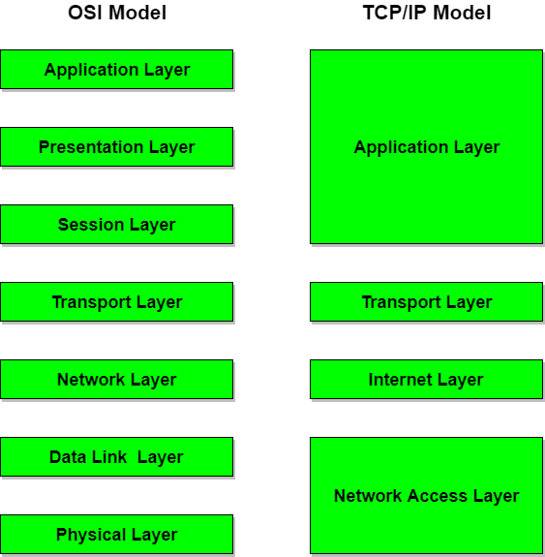
Introduction
The transport layer in the TCP/IP suite is located between the application layer and the network layer.
It provides services to the application layer and receives services from the network layer.
The transport layer acts as a liaison between a client program and a server program, a Process-to-Process connection.
The transport layer is the heart of the TCP/IP protocol suite.
Figure: Transport Layer in OSI and TCP/IP Model

Slide 9
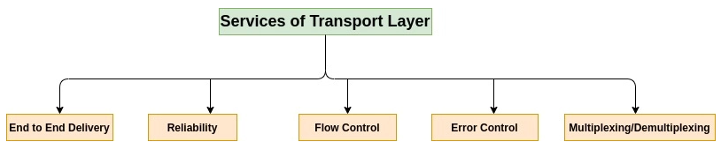
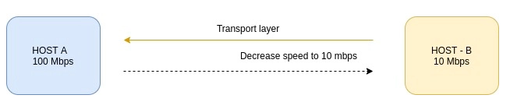
Transport Layer Services

Slide 10
Transport Layer Services
The transport layer provides:
Efficient, Reliable, and cost-effective data transmission service to its users.
It provides a Process-to-Process communication between two application layers.
A transport-layer protocol provides for logical communication between application processes running on different hosts.
Host-to-Host communication vs. Process-to-Process communication.

Slide 11
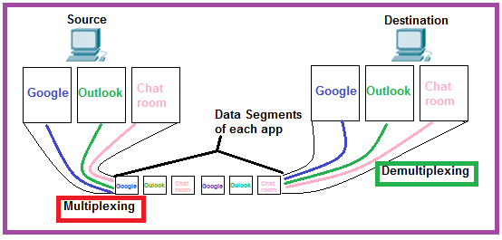
Transport Layer Services (Cntd.)
Process to Process delivery
End-to-End Connection between hosts
Multiplexing and Demultiplexing
Congestion Control –
Open loop congestion control
Closed loop congestion control
Data integrity and Error correction
Flow control

Slide 12
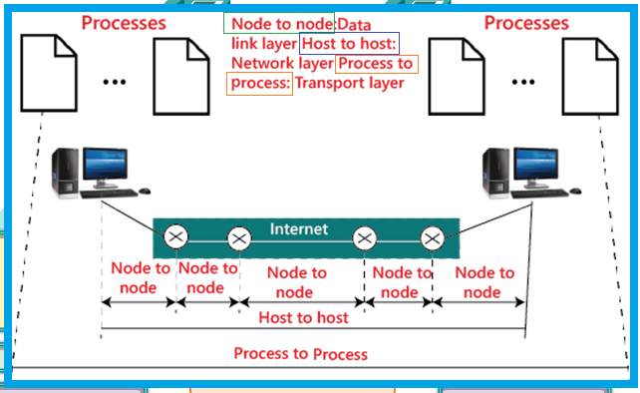
Process to Process delivery

Slide 13
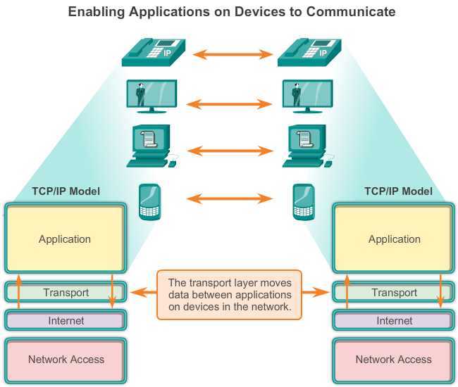
End-to-End Connection between hosts

Slide 14
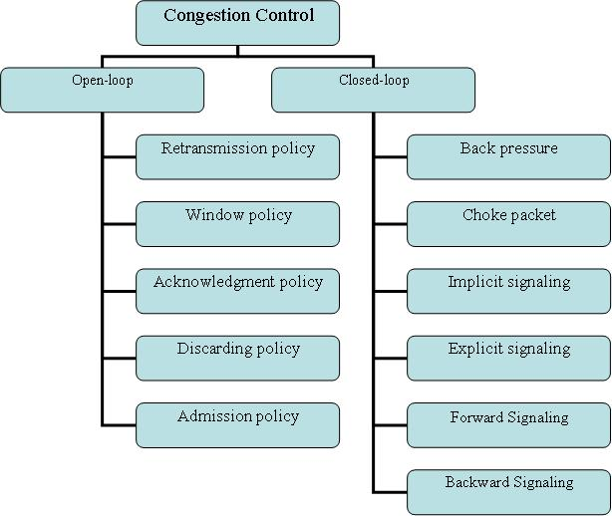
Congestion Control – Open loop congestion control and Closed loop congestion control

Slide 15
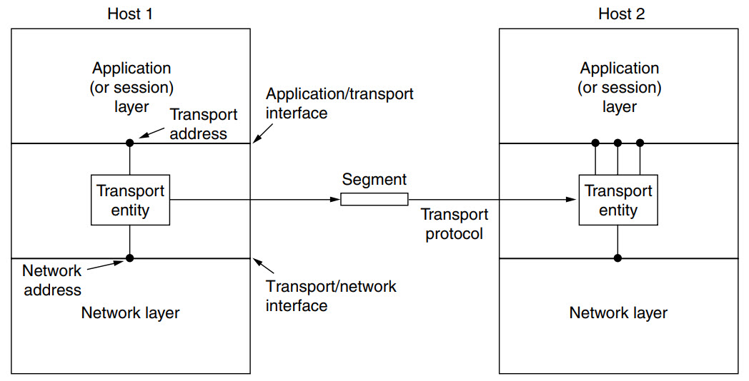
Transport Primitives
Transport entity -
The (logical) relationship of the network, transport, and application layers is illustrated in Figure.
On the sending side, the transport layer converts the application-layer messages it receives from a sending application process into transport-layer packets, known as transport-layer segments in Internet terminology.
Figure: The (logical) relationship of the network, transport, and application layers

Slide 16
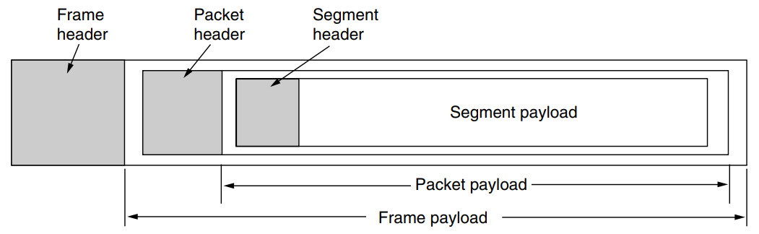
Transport Primitives
a segments.
a transport-layer header.
a network-layer packet (a datagram).
Figure: Nesting of segments, packets, and frames.

Slide 17
Transport Primitives
To allow users to access the transport service, the transport layer must provide, a transport service interface.
The transport service is similar to the network service, but there are also some important differences. The main difference is that the network service is intended to model the service offered by real networks, warts and all. Real networks can lose packets, so the network service is generally unreliable. The connection-oriented transport service, in contrast, is reliable.
Of course, real networks are not error-free, but that is precisely the purpose of the transport layer—to provide a reliable service on top of an unreliable network.
As an aside, the transport layer can also provide unreliable (datagram) service.

Slide 18
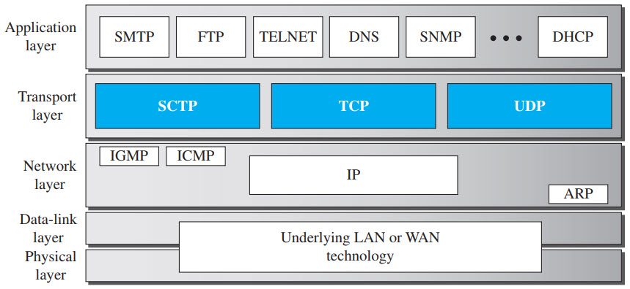
Transport Primitives
Transport Protocols –
Internet Protocol (IP) provides a packet delivery service across the internet
IP cannot distinguish between multiple processes (applications) running on the same computer
Fields in the IP datagram header identify only computers.
A protocol that allows an application to serve as an end-point of communication is known as a transport protocol or an end-to-end protocol.
The TCP/IP protocol suite provides two transport protocols:
The User Datagram Protocol (UDP)
The Transmission Control Protocol (TCP)
Stream Control Transmission Protocol
Figure: Position of transport-layer protocols in the TCP/IP protocol suite

Slide 19
Transport Primitives
Transport Protocols Services –
Each protocol provides a different type of service and should be used appropriately.
UDP:
UDP is an unreliable connectionless transport-layer protocol used for its simplicity and efficiency in applications where error control can be provided by the application-layer process.
TCP:
TCP is a reliable connection-oriented protocol that can be used in any application where reliability is important.
SCTP: (Stream Control Transmission Protocol is a connection-oriented network protocol to transmit multiple data streams between endpoints.)
SCTP is a transport-layer protocol that combines the features of UDP and TCP.

Slide 20
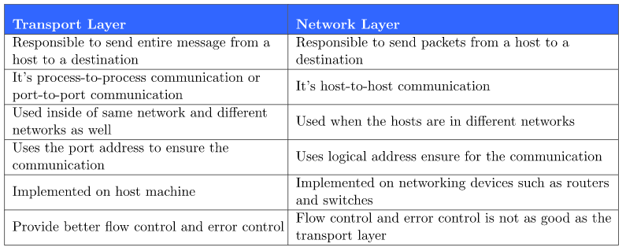
Transport Layer Vs. Network Layer

Slide 21
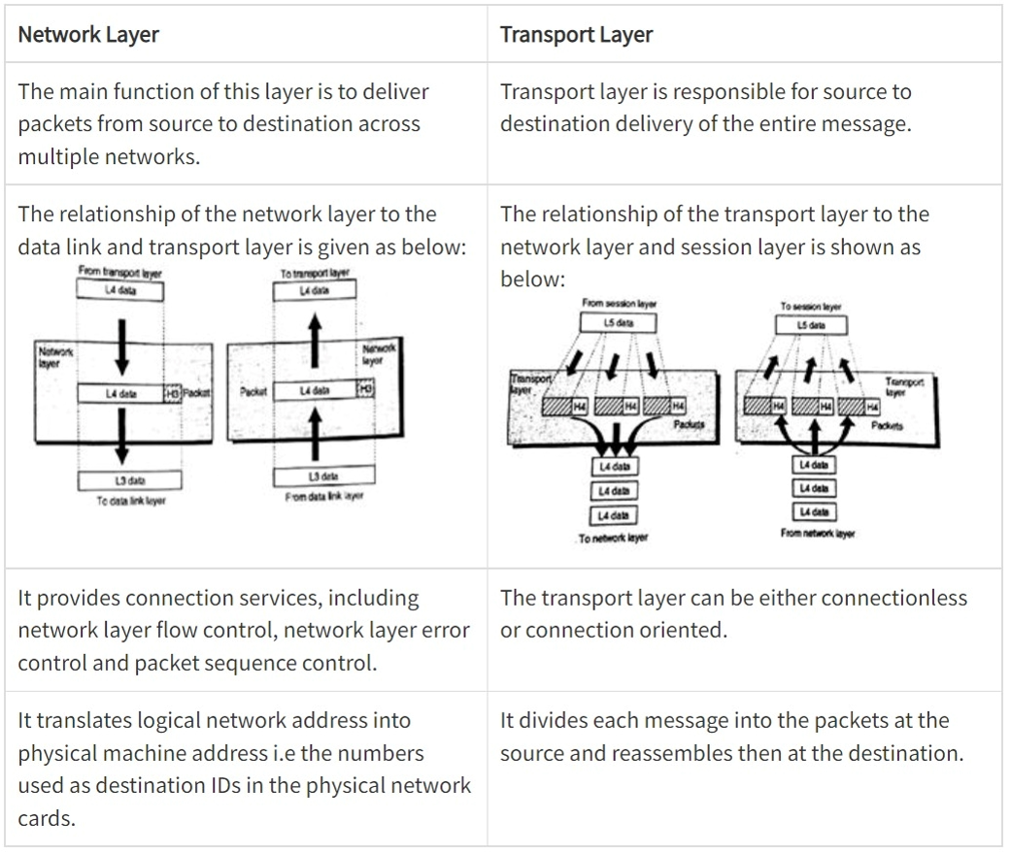
Transport Layer Vs. Network Layer

Slide 22
Client Server Architecture
There are several ways to achieve Process-to-Process communication, the most common one is through the Client/Server paradigm.
A process on the local host, called a client, needs services from a process usually on the remote host, called a server.
Both processes (client and server) have the same name. For example, to get the day and time from a remote machine, we need a Daytime client process running on the local host and a Daytime server process running on a remote machine.
Operating systems today support both multiuser and multiprogramming environments.
A remote computer can run several server programs at the same time, just as local computers can run one or more client programs at the same time.

Slide 23
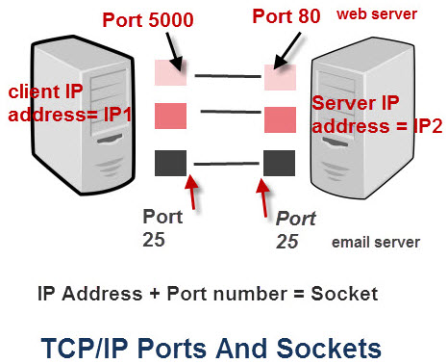
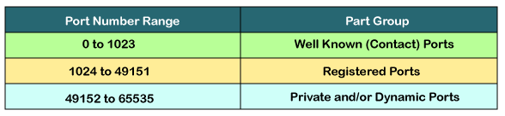
Port Numbers
lANA Ranges:
The lANA (Internet Assigned Number Authority) has divided the port numbers into three ranges: well known, registered, and dynamic (or private).
On a TCP/IP network the IP address identifies the device e.g. computer.
However an IP address alone is not sufficient for running network applications, as a computer can run multiple applications and/or services.
Just as the IP address identifies the computer, The network port identifies the application or service running on the computer.
SMTP
Well known ports: Web servers normally use port 80 and SMTP servers use port 25
Figure: TCP/IP ports and sockets

Slide 24
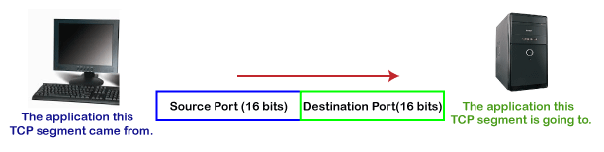
Port Numbers (Cntd.)
A transport-layer protocol creates a Process-to-Process communication.
These protocols use port numbers to accomplish this.
Port numbers provide end-to-end addresses at the transport layer
It allows multiplexing and demultiplexing at this layer, just as IP addresses do at the network layer.

Slide 25
Port Numbers (Cntd.)
A port number uses 16 bits and so can therefore have a value from 0 to 65535 decimal.
Port numbers are divided into ranges as follows:
Port numbers 0-1023 – Well known Ports – e.g. Web servers normally use port 80 and SMTP servers use port 25
Ports 1024-49151 – Registered Port.
Ports 49152-65535 – Dynamic Ports – These are used by client programs. Also known as ephemeral ports.

Slide 26
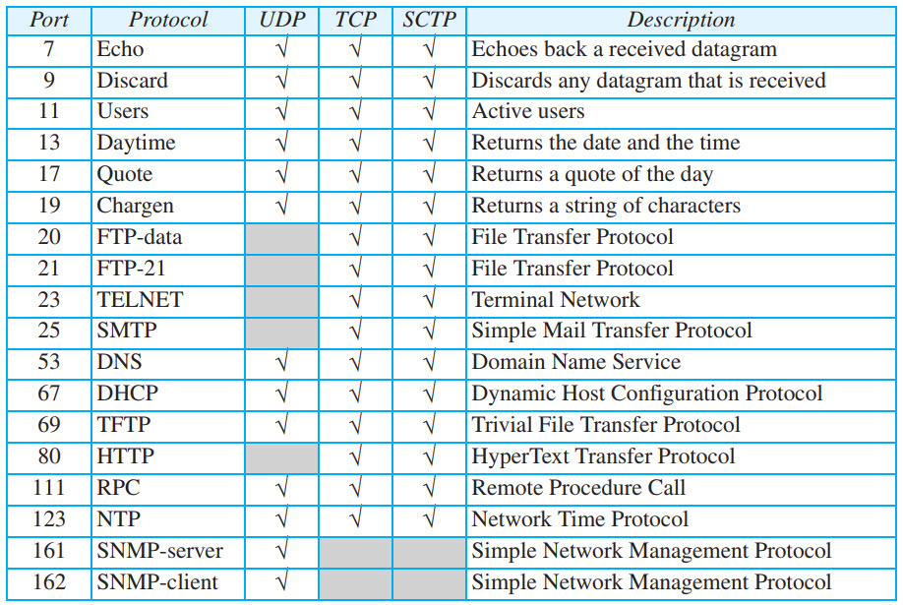
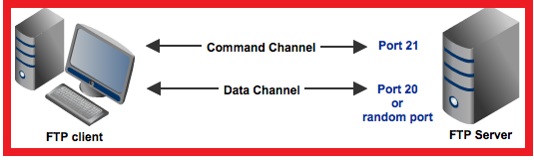
Some Common Port Numbers being used: Port Numbers (Cntd.)
Figure: Some well-known ports used with UDP and TCP

Slide 27
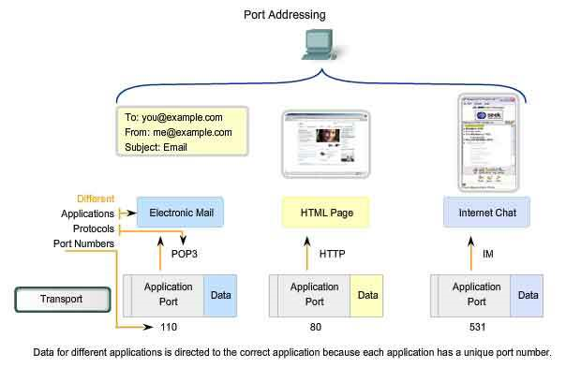
Port Numbers (Cntd.)
Post Office Protocol
Hyper Text Transfer Protocol.

Slide 28
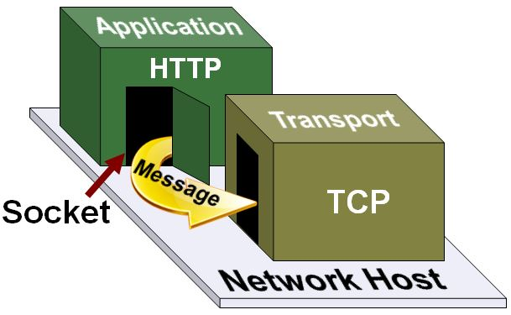
Sockets (Cntd.)
A socket is a software concept for a connection.
Sockets enable applications to connect to transport layer protocol (TCP/IP / UDP / SCTP).
An application running on a host creates a socket to connect with an application on another host.
Messages pass through this socket.

Slide 29
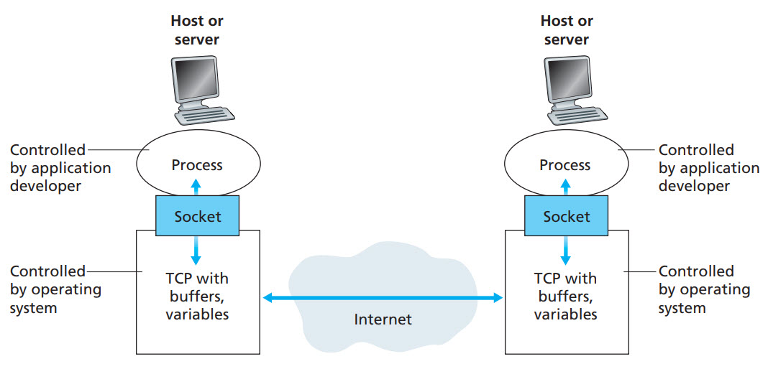
Sockets
A process sends messages into, and receives messages from, the network through a software interface called a Socket.
Figure illustrates socket communication between two processes that communicate over the Internet.
(Figure assumes that the underlying transport protocol used by the processes is the Internet’s TCP protocol.)

Slide 30
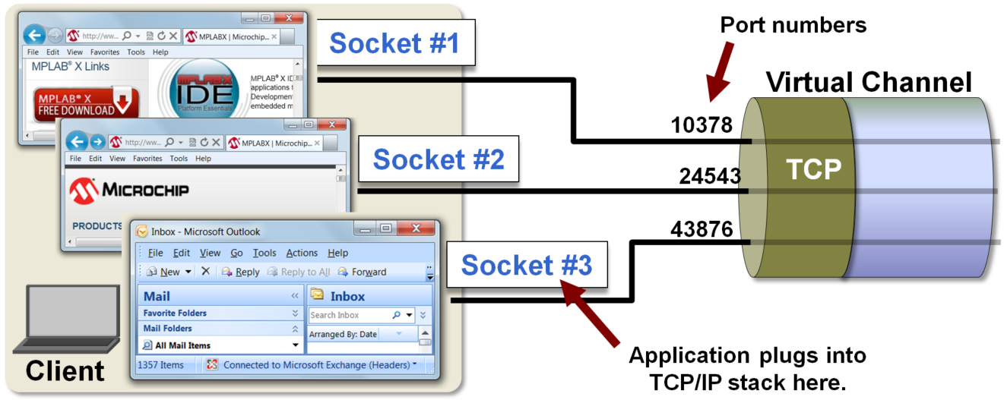
Sockets (Cntd.)
Three applications requiring three TCP communication channels:
Two channels for each of the two web browsers acting as HTTP clients, and one for the email application acting as an SMTP client.

Slide 31
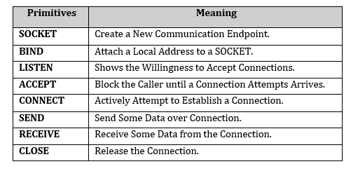
Sockets (Cntd.)
Berkeley Socket:
Berkeley sockets is an Application Programming Interface (API) for Internet sockets and UNIX domain sockets.
It is used for Inter-Process Communication (IPC).
It is commonly implemented as a library of linkable modules.
It originated with the 4.2BSD (Berkeley Software Distribution) refers to the particular version of the UNIX operating system that was developed at and distributed from the University of California at Berkeley.) UNIX released in 1983.
Primitives used in Berkeley Socket

Slide 32
Connectionless and Connection Oriented Protocol
A transport-layer protocol, like a network-layer protocol, can provide two types of services: connectionless and connection-oriented.
The nature of these services at the transport layer, however, is different from the ones at the network layer.
At the network layer, a connectionless service may mean different paths for different datagrams belonging to the same message; connection-oriented means dedicated path established before communication initiated.
At the transport layer, we are not concerned about the physical paths of packets (we assume a logical connection between two transport layers).
Connectionless service at the transport layer means independency between packets;
connection-oriented means dependency.
The connectionless protocol is UDP.
The connection-oriented protocol is TCP.

Slide 33
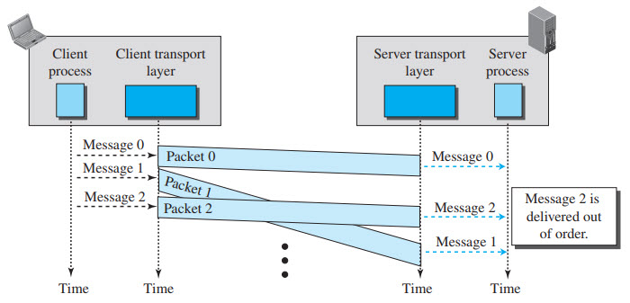
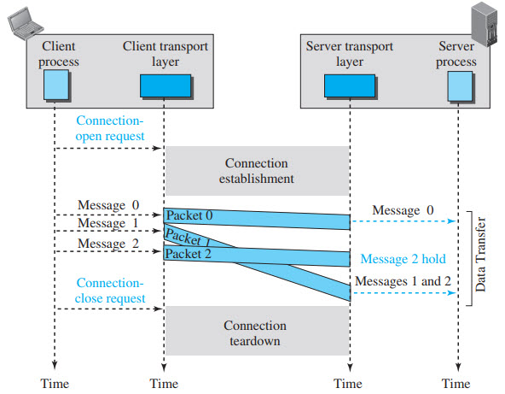
Connectionless and Connection Oriented Protocol (Cntd.)
Connectionless Service: independency between packets
Connection-oriented Service: Dependency between packets
Figure: Connectionless service

Slide 34
Transmission Control Protocol [TCP]
Transmission Control Protocol (TCP) is a connection-oriented, reliable protocol.
Connection-Oriented Service – explicitly defines connection establishment, data transfer, and connection teardown (Closing/ Releasing) phases.
TCP Applications:
Useful for applications that require reliable data delivery, and can tolerate some timing variation
File transfer and web downloads
Email
Instant messaging

Slide 35
Transmission Control Protocol [TCP] (Cntd.)
TCP Services:
Process to process communication – using socket address
Stream delivery service –
Sending/Receiving process to deliver/obtain data as a stream of bytes.
Sending and Receiving buffers
TCP Segments
Full Duplex Communication
Multiplexing and Demultiplexing – multiplexing at sender & demultiplexing at receiver. However connection need to be established for each pair of processes
Connection-Oriented service – Connection establishment, data transfer, connection termination
Reliable Service – use of acknowledgement.

Slide 36
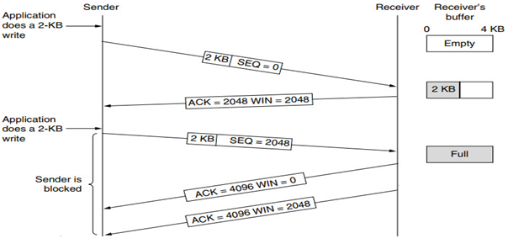
Transmission Control Protocol [TCP] (Cntd.)
TCP Features:
Numbering System –
Byte Number –
The bytes of data being transferred in each connection are numbered by TCP.
Numbering is independent in each direction.
The numbering starts with an arbitrarily generated number.
Sequence Number – (32 Bits)
defines the number assigned to the first data byte contained in that segment.
Acknowledgement Number – (32 Bits)
defines the number of the next byte a party expects to receive.
The acknowledgment number is cumulative.

Slide 37
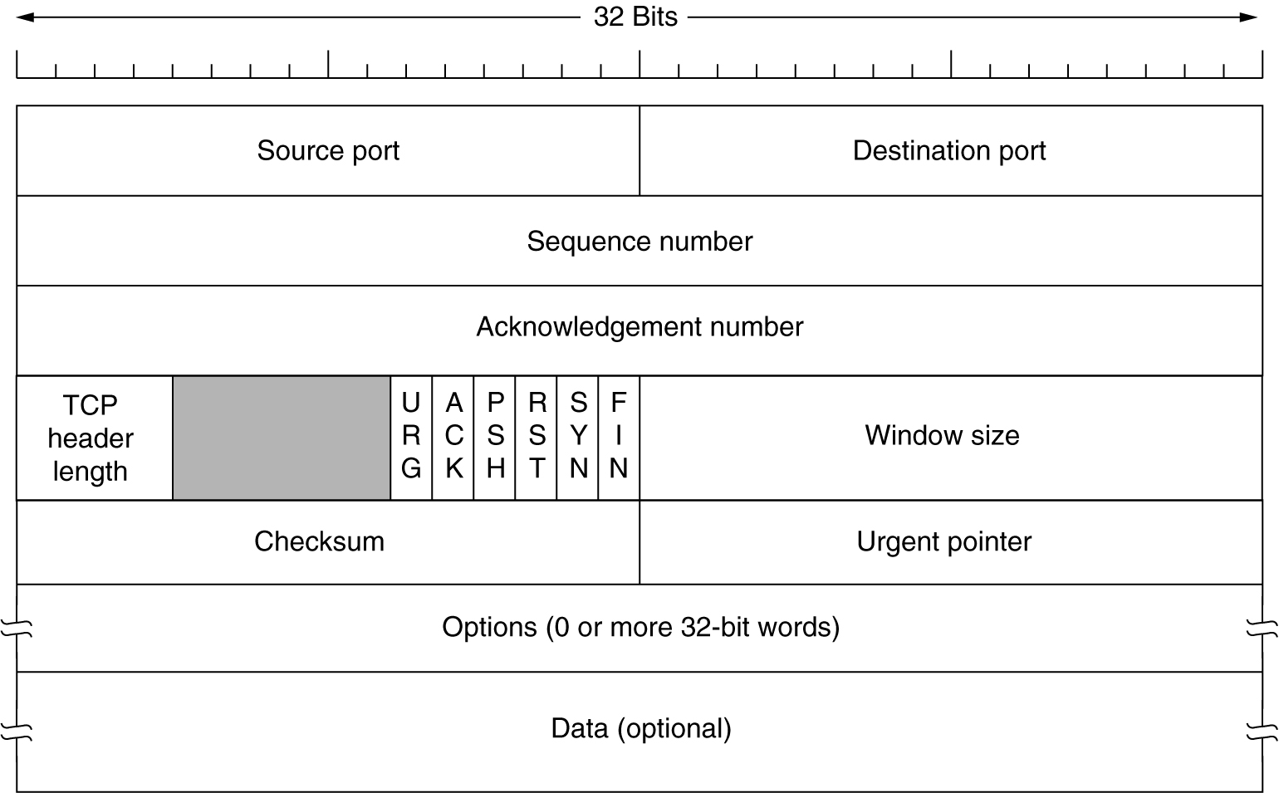
TCP Segment format
16-bits
16-bits
4-bit
Closing / Releasing of TCP Connection
Reserved (2-bits):
FIN: Graceful connection release
RST- Abrupt connection release
Figure: TCP segment format. (Size of TCP Header is in between 20 Bytes to 60 Bytes)

Slide 38
Transmission Control Protocol [TCP] (Cntd.)
Source Port (16-bits):
It identifies source port of the application process on the sending device.
Destination Port (16-bits):
It identifies destination port of the application process on the receiving device.
Sequence Number (32-bits):
Sequence number of data bytes of a segment in a session.
Acknowledgement Number (32-bits):
When ACK flag is set, this number contains the next sequence number of the data byte expected and works as acknowledgement of the previous data received.
Header Length (HLEN) This is a 4-bit field that indicates the length of the TCP header by a number of 4-byte words in the header, i.e if the header is 20 bytes (min length of TCP header), then this field will hold 5 (because 5 x 4 = 20) and the maximum length: 60 bytes, then it’ll hold the value 15(because 15 x 4 = 60). Hence, the value of this field is always between 5 and 15.

Slide 39
Transmission Control Protocol [TCP] (Cntd.)
Window size – This field tells the window size of the sending TCP in bytes. Checksum – This field holds the checksum for error control. It is mandatory in TCP as opposed to UDP. Urgent pointer – This field (valid only if the URG control flag is set) is used to point to data that is urgently required that needs to reach the receiving process at the earliest. The value of this field is added to the sequence number to get the byte number of the last urgent byte.
Reserved (3-bits):
Reserved for future use and all are set zero by default.

Slide 40
Transmission Control Protocol [TCP] (Cntd.)
Synchronization (SYN) -
It is used in first step of connection establishment phase or 3-way handshake process between the two hosts. Only the first packet from sender as well as receiver should have this flag set. This is used for synchronizing sequence number i.e. to tell the other end which sequence number they should accept.
Acknowledgement (ACK) –
It is used to acknowledge packets which are successfully received by the host. The flag is set if the acknowledgement number field contains a valid acknowledgement number. Finish (FIN) – It is used to request for connection termination i.e. when there is no more data from the sender, it requests for connection termination. This is the last packet sent by sender. It frees the reserved resources and gracefully terminate the connection. Reset (RST) –
It is used to terminate the connection if the sender feels something is wrong with the TCP connection or that the conversation should not exist. It can get send from receiver side when packet is send to particular host that was not expecting it.

Slide 41
Transmission Control Protocol [TCP] (Cntd.)
Push (PSH) – Transport layer by default waits for some time for application layer to send enough data equal to maximum segment size.
Sender Transport layer sets PSH = 1 and immediately sends the segment to network layer as soon as it receives signal from application layer. Receiver transport layer, on seeing PSH = 1 immediately forwards the data to application layer.
Urgent (URG) –Data inside a segment with URG = 1 flag is forwarded to application layer immediately even if there are more data to be given to application layer. It is used to notify the receiver to process the urgent packets before processing all other packets. The receiver will be notified when all known urgent data has been received.

Slide 42
Transmission Control Protocol -TCP (Cntd.)
Connection Establishment: Three way Handshaking
A TCP connection is opened by a three-way handshake to establish a common view of the sequence numbers.
A connection will be initiated by an active client, the other end of the connection is described as the passive client.
The passive client should be in a state known as LISTEN which simply means that it is expecting an incoming connection request.
The three way exchange involves the active client sending a SYN segment with the sequence number set to an arbitrary value (J).
The passive client responds with a SYN segment with the acknowledgment number set to J+1 and the sequence number set to a further arbitrary value (K).
The active client responds to the SYN segment by sending an ACK segment with the acknowledgment number set to K+1.

Slide 43
Transmission Control Protocol [TCP] (Cntd.)
Windows in TCP: TCP uses two windows (send window and receive window) for each direction of data transfer
Senders send 2KB of data along with Seq no.
Receiver sends ACK of previous SEQ no and send remaining window size WIN (2048)
Sender again send 2KB of data to receiver.
Now at Receivers side buffer gets full, so he sends ACK of previous SEQ no and WIN =0. Sender is in blocked state until some memory of receiver's buffer is empty.
Receivers buffer is always full until it PUSH the data to application layer
This state is called Silly window syndrome problem

Slide 44
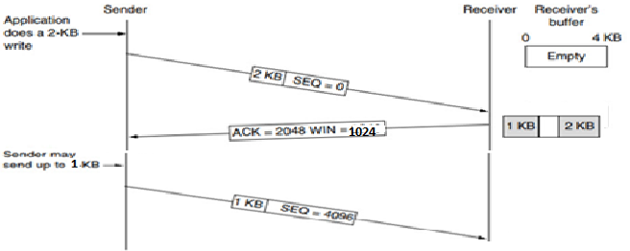
Transmission Control Protocol [TCP] (Cntd.)
To resolve Silly Window Syndrome problem, receiver sends half of the remaining window size
As shown in dig. Instead of sending 2KB of free space receiver sends 1 KB as a window size
So receiver will always have 1Kb of remaining window size.
Application always read the data of 1KB (in this problem), so receiver will never have buffer full problem and sender will not be in block state.
This is called as Nagle’s algorithm.
Figure: TCP Sliding window example.

Slide 45
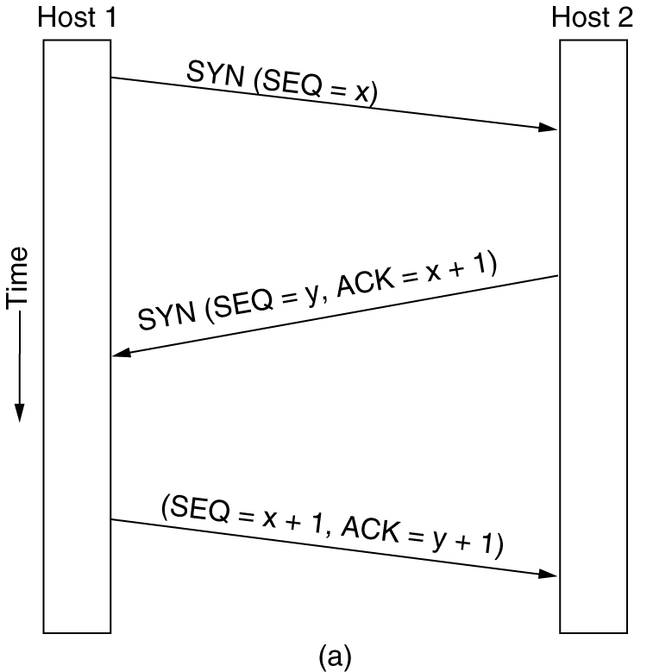
Transmission Control Protocol [TCP] (Cntd.)
1. Connection Establishment: Three way Handshaking
Host 1 chooses a sequence number, x, and sends a CONNECTION REQUEST segment containing it to host 2.
Host 2 replies with an ACK segment acknowledging x and announcing its own initial sequence number, y.
Finally, host 1 acknowledges host 2’s choice of an initial sequence number in the first data segment that it sends.

Slide 46
Transmission Control Protocol [TCP] (Cntd.)
2. Closing / Releasing of TCP Connection
TCP supports two types of connection releases like most connection-oriented transport protocols:
Graceful connection release – In the Graceful connection release, the connection is open until both parties have closed their sides of the connection.
Abrupt connection release – In an Abrupt connection release, either one TCP entity is forced to close the connection or one user closes both directions of data transfer.

Slide 47
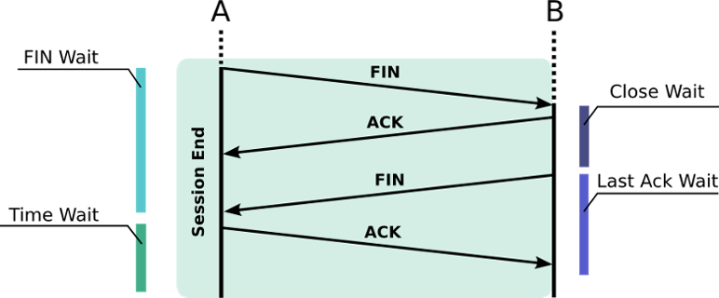
Transmission Control Protocol [TCP] (Cntd.)
Graceful Connection Release : The common way of terminating a TCP connection is by using the TCP header’s FIN flag.
A sends a FIN packet and waits for a response; it can release some resources but awaits the response of the other part (Fin Wait)
B receives the FIN packet and must release resources; it waits for a closing application level (Close Wait)
B can now send a FIN to A and then await its acknowledgement (Last Ack wait).
A can now fully close its job, but it must wait for network collision (Time Wait); it may have to send the final ACK another time.
B eventually receives the final ACK and destroys (kills) the connection.`

Slide 48
Transmission Control Protocol [TCP] (Cntd.)
Closing / Releasing of TCP Connection
Abrupt connection release : An abrupt connection release is carried out when an RST segment is sent. An RST segment can be sent for the below reasons:
When a non-SYN segment was received for a non-existing TCP connection. In an open connection, some TCP implementations send an RST segment when a segment with an invalid header is received. This will prevent attacks by closing the corresponding connection. When some implementations need to close an existing TCP connection, they send an RST segment. They will close an existing TCP connection for the following reasons:
Lack of resources to support the connection
The remote host is now unreachable and has stopped responding.

Slide 49
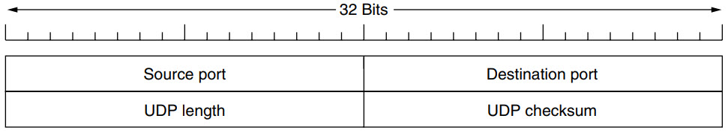
User Datagram Protocol [UDP]
Connectionless Transport Protocol.
UDP transmits segments consisting of an 8-byte fixed size header followed by the payload.
The header is shown below UDP header in hexadecimal format CB84000D001C001C
What is the source port number?
What is the destination port number?
What is the total length of the user datagram?
What is the length of the data? (28-8=20)
Is the packet directed from a client to a server or vice versa?
What is the client process?
CB84
000D
8+20=001C=28
001C=28
001C
UDP header + Data=28
Figure: The UDP header.

Slide 50
User Datagram Protocol [UDP] (Cntd.)
Question: The following is the content of a UDP header in hexadecimal format.
CB84000D001C001C
What is the source port number?
What is the destination port number?
What is the total length of the user datagram?
What is the length of the data?
Is the packet directed from a client to a server or vice versa?
What is the client process?
Solution: Try to Solve It…….

Slide 51
User Datagram Protocol [UDP] (Cntd.)
CB84000D001C001C
Solution:
The source port number is the first four hexadecimal digits CB84H, which means that the source port number is 52100.
The destination port number is the second four hexadecimal digits 000DH, which means that the destination port number is 13.
The third four hexadecimal digits 001CH define the length of the whole UDP packet as 28 bytes.
The length of the data is the length of the whole packet minus the length of the header, or 28 − 8 = 20 bytes.
Since the destination port number is 13 (well-known port- Daytime), the packet is from the client to the server.
The client process is the Daytime (see slide no. 19).
UDP header + Data= “Total UDP length” field in UDP packet header

Slide 52
User Datagram Protocol [UDP] (Cntd.)
UDP Services:
Process to Process communication – using socket address
Connectionless services
Flow Control – Not present
Error Control – Not present
Checksum – based on pseudo header, UDP header, and data (Can be Optional)
Congestion Control – Not present
Encapsulation & Decapsulation
Queuing
Multiplexing & Demultiplexing

Slide 53
User Datagram Protocol [UDP] (Cntd.)
UDP Applications:
UDP is suitable for a process that requires simple request-response communication with little concern for flow and error control.
UDP is suitable for a process with internal flow- and error-control mechanisms. For example, the Trivial File Transfer Protocol (TFTP).
UDP is a suitable transport protocol for multicasting.
UDP is used for management processes such as SNMP (Simple Network Management Protocol).
UDP is used for some route updating protocols such as Routing Information Protocol (RIP).
UDP is normally used for interactive real-time applications that cannot tolerate uneven delay between sections of a received message. E.g. multimedia applications.
Client-server RPC (Remote Procedure Call is a powerful technique for constructing distributed, client-server based applications is one area in which UDP is widely used.

Slide 54
Real-Time Transport Protocol (RTP)

Slide 55
Real-Time Transport Protocol [RTP]
Multimedia Applications such as Internet radio, Internet telephony, music-on-demand, video conferencing, video-on-demand, and other are reinventing more or less the same real-time transport protocol.
Thus generic real-time transport protocol for multiple applications would be a good idea. i.e. RTP (Real-time Transport Protocol).
Aspects of real-time transport:
Transporting Audio and Video data in packets.
Processing that takes place, mostly at the receiver, to play out the audio and video at the right time.

Slide 56
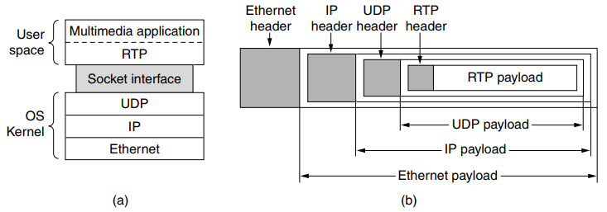
Real-Time Transport Protocol [RTP] (Cntd.)
Figure: (a) The position of RTP in the protocol stack. (b) Packet nesting.

Slide 57
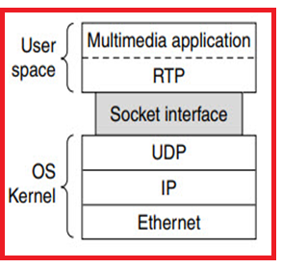
Real-Time Transport Protocol [RTP] (Cntd.)
RTP normally runs in user space over UDP (in the operating system).
Its works as follows:
Because of this design, it is a little hard to say which layer RTP is in. (see previous figure)
looks like an application protocol – because it runs in user space and is linked to the application program.
looks like a transport protocol – because it is a generic, application independent protocol that just provides transport facilities
Multimedia
application
Fed into
RTP
library
Multiplexing
RTP
Packets
Through Sockets
UDP
Packets
IP
Packets
Ethernet

Slide 58
Real-Time Transport Protocol [RTP] (Cntd.)
Basic function – Multiplex several real-time data streams onto a single stream of UDP packets.
Unicasting or Multicasting can be done.
There are no special guarantees about delivery, and packets may be lost, delayed, corrupted, etc.
The RTP format contains several features to help receivers work with multimedia information.
Sequence Numbering
Encoding for Different profiles such as audio, video etc.
Time stamping

Slide 59
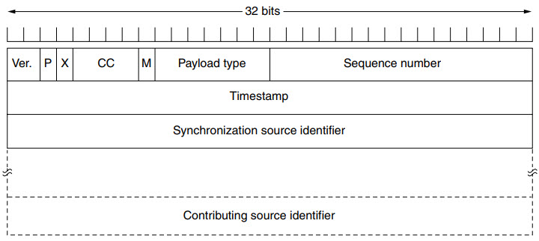
Real-Time Transport Protocol [RTP] (Cntd.)
X-Extension of header
M-end marker
helps in checking lost packets and order mismatch
4-bit
7-bit
16 bits
P-Padding
Contributor count
is used to find relationship between times of different RTP packets.
32-bit
This mainly helps in solving conflict arises when two sources started with the same sequencing number.
Figure: The RTP header.

Slide 60
Real-Time Transport Protocol [RTP] (Cntd.)
P – The length of this field is 1-bit. If value is 1, then it denotes presence of padding at end of packet and if value is 0, then there is no padding.
X – The length of this field is also 1-bit. If value of this field is set to 1, then its indicates an extra extension header between data and basic header and if value is 0 then, there is no extra extension.
Contributor count – This 4-bit field indicates number of contributors. Here maximum possible number of contributor is 15 as a 4-bit field can allows number form 0 to 15.
M – The length of this field is 1-bit and it is used as end marker by application to indicate end of its data.

Slide 61
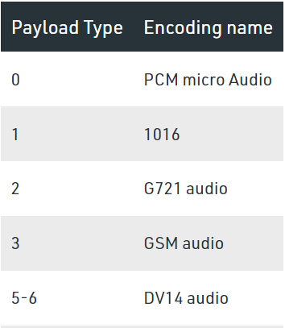
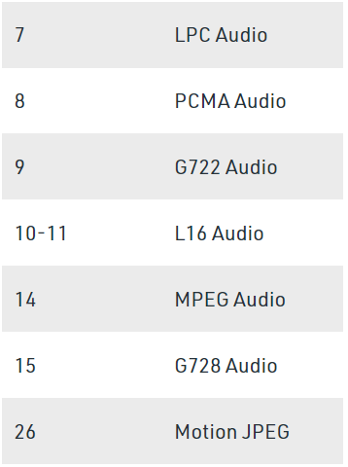
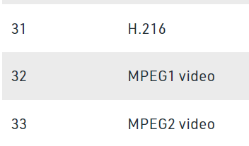
Real-Time Transport Protocol [RTP] (Cntd.)
Payload types – This field is of length 7-bit to indicate type of payload. We list applications of some common types of payload.

Slide 62
Real-Time Transport Protocol [RTP] (Cntd.)
Time Stamp – The length of this field is 32-bit. It is used to find relationship between times of different RTP packets. The timestamp for first packet is given randomly and then time stamp for next packets given by sum of previous timestamp and time taken to produce first byte of current packet. The value of 1 clock tick is varying from application to application.
Sequence Number – The length of this field is 16 bits. It is used to give serial numbers to RTP packets. The sequence number for first packet is given a random number and then every next packet’s sequence number is incremented by 1. This field mainly helps in checking lost packets and order mismatch.

Slide 63
Real-Time Transport Protocol [RTP] (Cntd.)
Synchronization Source Identifier – This is a 32-bit field used to identify and define the source. The value for this source identifier is a random number that is chosen by source itself. This mainly helps in solving conflict arises when two sources started with the same sequencing number.
Contributor Identifier – This is also a 32-bit field used for source identification where there is more than one source present in session. The mixer source use Synchronization source identifier and other remaining sources (maximum 15) use Contributor identifier.

Slide 64
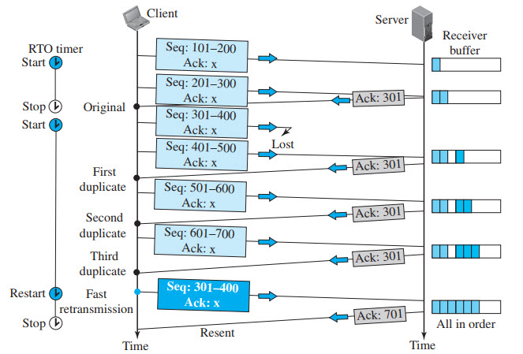
TCP: Error Control
Error Control:-
Retransmission Time Out
The heart of the error control mechanism is the retransmission of segments.
When retransmission is possible?: When a segment is sent, it is stored in a queue until it is acknowledged.
When the retransmission timer expires, or
When the sender receives three duplicate ACKs for the first segment in the queue, that segment is retransmitted.

Slide 65
TCP: Error Control (Cntd.)
TCP is a reliable transport layer protocol. TCP provides reliability using error control.
Error control includes mechanisms for detecting----
Corrupted segments.
Lost segments.
Out-of-order segments.
Duplicated segments.
Error detection and correction tools: in TCP is achieved through the use of three simple tools:
Checksum.
Acknowledgment.
Time-out.

Slide 66
TCP: Error Control (Cntd.)
Checksum : Each segment includes a checksum field which is used to check for a corrupted segment. If the segment is corrupted, it is discarded by the destination TCP and is considered as lost. TCP uses a 16-bit checksum that is mandatory in every segment.
Acknowledgment : TCP uses acknowledgments to confirm the receipt of data segments. Control segments that carry no data but consume a sequence number are also acknowledged. ACK segments are never acknowledged.
Retransmission : The heart of the error control mechanism is the retransmission of segments. When a segment is corrupted, lost, or delayed, it is retransmitted.
In modern implementations, a segment is retransmitted on two occasions:
When a retransmission timer expires or
When the sender receives three duplicate ACKs.

Slide 67
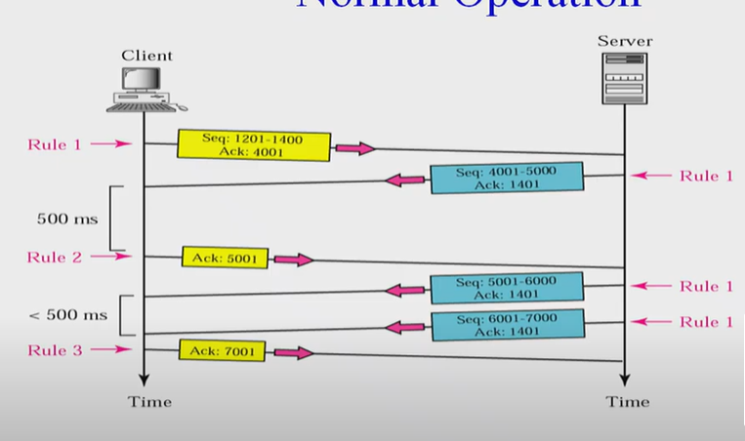
TCP: Error Control (Cntd.)
Error Control (Cntd.): Scenarios Normal operation

Slide 68
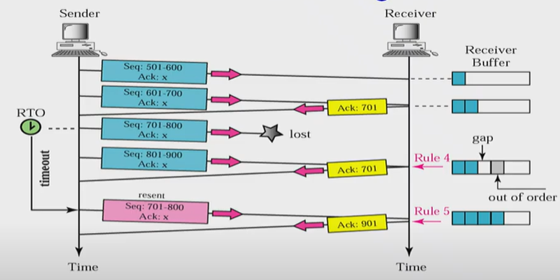
TCP: Error Control (Cntd.)
Retransmission (Cntd.)
Retransmission after retransmission time-out (RTO):
Sending TCP maintains one retransmission time-out (RTO) for each connection.
When the timer matures, i.e. times out, TCP resends the segment.
The value of RTO is dynamic in TCP and is updated based on the round-trip time (RTT) of segments.

Slide 69
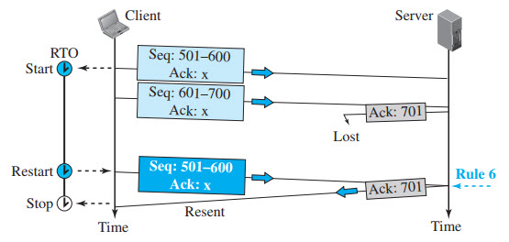
TCP: Error Control (Cntd.)
Retransmission (Cntd.)
Retransmission after retransmission time-out (RTO):
Lost acknowledgment corrected by resending a segment

Slide 70
TCP: Error Control (Cntd.)
Retransmission after Three Duplicate ACK Segments:
Goal in this retransmission method is to allowing senders to retransmit without waiting for a time out.
if three duplicate acknowledgments (i.e., an original ACK plus three exactly identical copies) arrive for a segment, the next segment is retransmitted without waiting for the time-out.
This feature is called fast retransmission.

Slide 71
TCP: Error Control (Cntd.)
Error Control (Cntd.): Out of Order segments
Data may arrive out of order and be temporarily stored by the receiving TCP, but TCP guarantees that no out-of-order data are delivered to the process.

Slide 72
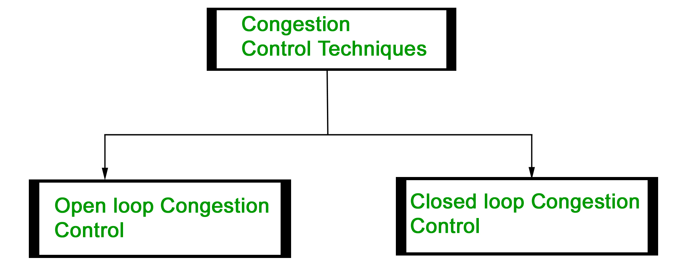
TCP: Congestion Control
Congestion control refers to Techniques and Mechanisms that can either Prevent congestion before it happens or Remove congestion after it has happened.
Prevention
Removal
Prevent congestion before it happens
Remove congestion after it has happened.

Slide 73
TCP: Congestion Control (Cntd.)
Congestion Control: Open-Loop Congestion Control (Prevention)
Open loop congestion control policies are applied to prevent congestion before it happens.
The congestion control is handled either by the source or the destination.
There is a brief list of policies that can prevent congestion.
Retransmission Policy
Window Policy
Acknowledgement Policy
Discarding Policy
Admission Policy (first check the resource requirement of a network flow before transmitting it further.)

Slide 74
TCP: Congestion Control (Cntd.)
Open-Loop Congestion Control Policies
Retransmission Policy : If the sender feels that a sent packet is lost or corrupted, the packet needs to be retransmitted.
This transmission may increase the congestion in the network. To prevent congestion, retransmission timers must be designed to prevent congestion and also able to optimize efficiency.
Window Policy : The type of window at the sender’s side may also affect the congestion. Several packets in the Go-back-n window are re-sent, although some packets may be received successfully at the receiver side.
This duplication may increase the congestion in the network and make it worse. Therefore, Selective repeat window should be adopted as it sends the specific packet that may have been lost.

Slide 75
TCP: Congestion Control (Cntd.)
Discarding Policy : A good discarding policy adopted by the routers is that the routers may prevent congestion and at the same time partially discard the corrupted or less sensitive packages and also be able to maintain the quality of a message.
In case of audio file transmission, routers can discard less sensitive packets to prevent congestion and also maintain the quality of the audio file.
Acknowledgment Policy : Since acknowledgements are also the part of the load in the network, the acknowledgment policy imposed by the receiver may also affect congestion. Several approaches can be used to prevent congestion related to acknowledgment.
The receiver should send acknowledgement for N packets rather than sending acknowledgement for a single packet. The receiver should send an acknowledgment only if it has to send a packet or a timer expires.

Slide 76
TCP: Congestion Control (Cntd.)
Admission Policy : In admission policy a mechanism should be used to prevent congestion. Switches in a flow should first check the resource requirement of a network flow before transmitting it further.
If there is a chance of a congestion or there is a congestion in the network, router should deny establishing a virtual network connection to prevent further congestion.

Slide 77
Transmission Control Protocol [TCP] (Cntd.)
Congestion Control: Closed-Loop Congestion Control (Removal)
Closed-loop congestion control mechanisms try to alleviate (lighten) congestion after it happens.
Several mechanisms have been used by different protocols. We describe a few of them here.
Backpressure.
Choke Packet.
Implicit Signaling.
Explicit Signaling.

Slide 78
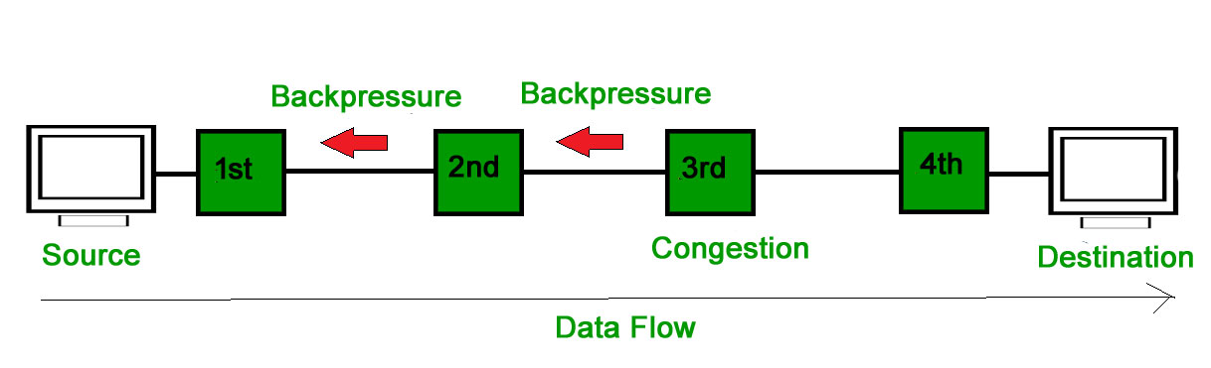
Transmission Control Protocol [TCP] (Cntd.)
Congestion Control: Closed-Loop Congestion Control (Removal) (Cntd.)
Backpressure :
Backpressure is a technique in which a congested node stops receiving packets from upstream node.
This may cause the upstream node or nodes to become congested and reject receiving data from above nodes.
Backpressure is a node-to-node congestion control technique that propagate in the opposite direction of data flow.
The backpressure technique can be applied only to virtual circuit where each node has information of its above upstream node.

Slide 79
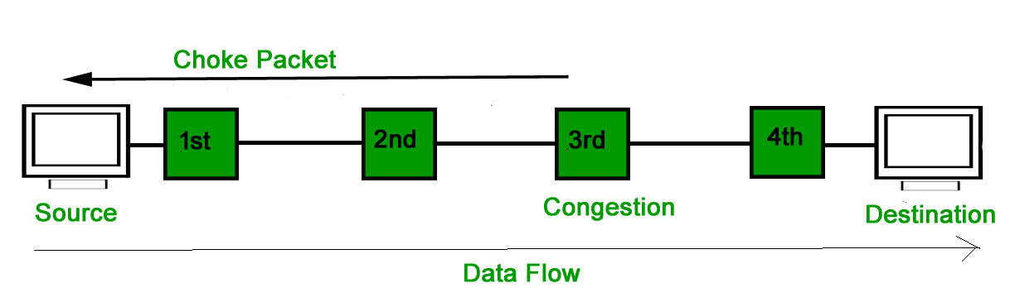
Transmission Control Protocol [TCP] (Cntd.)
Congestion Control: Closed-Loop Congestion Control (Removal) (Cntd.)
Choke Packet Technique :
Choke packet technique is applicable to both virtual networks as well as datagram subnets.
A choke packet is a packet sent by a node to the source to inform it of congestion.
Each router monitors its resources and the utilization at each of its output lines.
Whenever the resource utilization exceeds the threshold value which is set by the administrator, the router directly sends a choke packet to the source giving it a feedback to reduce the traffic.
The intermediate nodes through which the packets has traveled are not warned about congestion.

Slide 80
Transmission Control Protocol [TCP] (Cntd.)
Congestion Control: Closed-Loop Congestion Control (Removal) (Cntd.)
3. Implicit Signaling : In implicit signaling, there is no communication between the congested nodes and the source.
The source guesses that there is congestion in a network.
For example when sender sends several packets and there is no acknowledgment for a while, one assumption is that there is a congestion.
4. Explicit Signaling : In explicit signaling, if a node experiences congestion it can explicitly sends a packet to the source or destination to inform about congestion.
The difference between choke packet and explicit signaling is that the signal is included in the packets that carry data rather than creating a different packet as in case of choke packet technique.
Explicit signaling can occur in either forward or backward direction.
Forward Signaling : In forward signaling, a signal is sent in the direction of the congestion. The destination is warned about congestion. The receiver in this case adopt policies to prevent further congestion.
Backward Signaling : In backward signaling, a signal is sent in the opposite direction of the congestion. The source is warned about congestion and it needs to slow down.

Slide 81
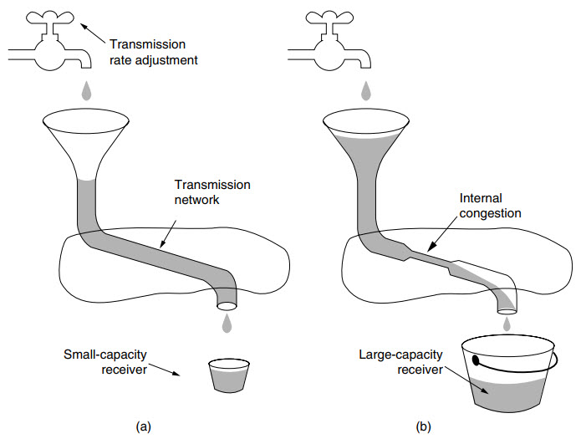
Transmission Control Protocol [TCP] (Cntd.)
Regulating the Sending Rate
Figure: (a) A fast network feeding a low-capacity receiver. (b) A slow network feeding a high-capacity receiver.

Slide 82
Transmission Control Protocol [TCP] (Cntd.)
Regulating the Sending Rate: A leaky bucket algorithm shapes bursty traffic into fixed-rate traffic by averaging the data rate. It may drop the packets if the bucket is full.
There are 2 types of Regulating the Sending Rate algorithms:
Leaky Bucket
Token Bucket

Slide 83
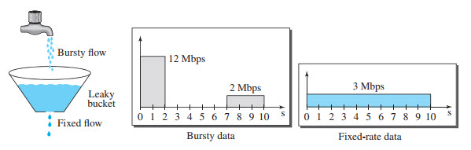
Leaky Bucket: Transmission Control Protocol [TCP] (Cntd.)
Assume that the network has committed a bandwidth of 3 Mbps for a host.
The use of the leaky bucket shapes the input traffic to make it conform to this commitment.
In Figure the host sends a burst of data at a rate of 12 Mbps for 2 s, for a total of 24 Mbits of data.
The host is silent for 5 s and then sends data at a rate of 2 Mbps for 3 s, for a total of 6 Mbits of data.
In all, the host has sent 30 Mbits of data in 10 s.
The leaky bucket smooths the traffic by sending out data at a rate of 3 Mbps during the same 10 s. Without the leaky bucket, the beginning burst may have hurt the network by consuming more bandwidth than is set aside for this host.
Figure: Leaky bucket.

Slide 84
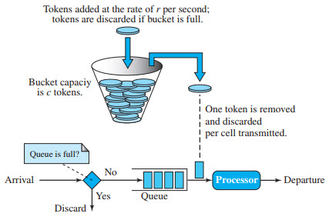
Token Bucket: Transmission Control Protocol [TCP] (Cntd.)
Regulating the Sending Rate (Cntd.): Token Bucket
The token bucket allows bursty traffic at a regulated maximum rate.
Step 1 − In regular intervals tokens are thrown into the bucket f.
Step 2 − The bucket has a maximum capacity c.
Step 3 − If the packet is ready, then a token is removed from the bucket, and the packet is sent.
Step 4 − Suppose, if there is no token in the bucket, the packet cannot be sent.
Figure: Token bucket.

Slide 85
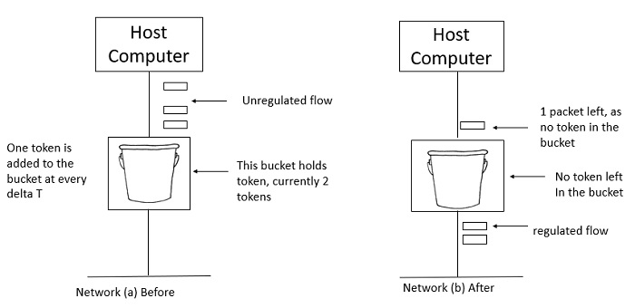
Token Bucket: Transmission Control Protocol [TCP] (Cntd.)
Regulating the Sending Rate (Cntd.): Token Bucket
In figure (a) the bucket holds two tokens, and three packets are waiting to be sent out of the interface.
In Figure (b) two packets have been sent out by consuming two tokens, and 1 packet is still left.
Figure: Token bucket.

Slide 86
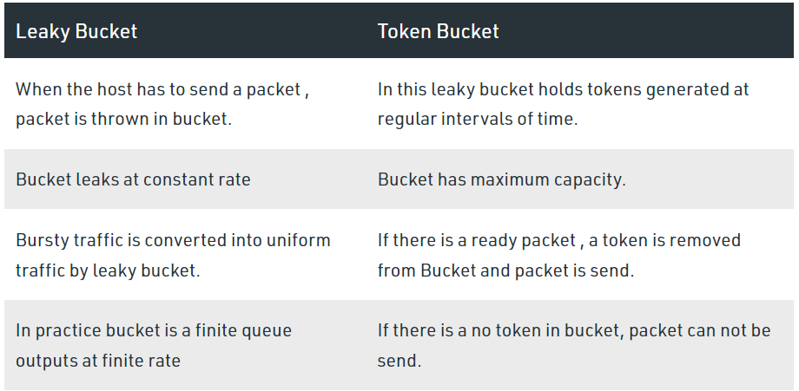
Transmission Control Protocol [TCP] (Cntd.)

Slide 87
Quality of Service [QoS]
Another way of looking at the transport layer is to regard its primary function as Enhancing the QoS (Quality of Service) provided by the network layer.
If the network service is poor, the transport layer has to bridge the gap between what the application users want and what the network layer provides.
The transport service may allow the user to specify preferred, acceptable, and minimum values for various service parameters at the time a connection is setup.

Slide 88
Quality of Service [QoS] (Cntd.)
QoS Parameters:
The connection establishment delay: The time difference between the instant at which a transport connection is requested and the instant at which it is confirmed is called as connection establishment delay
The connection establishment failure probability: It is the probability that connection is not established even after the maximum connection establishment delay. This problem will occur due to network congestion, lack of table space or some other problems.
Throughput: This parameter describes the average data transfer rate at the network transport level.
Transit delay: The delay refers to the time required to transmit a packet or a group of packets from the transmit end to the receive end.

Slide 89
Quality of Service [QoS] (Cntd.)
QoS Parameters
Residual error ratio: Residual error rate (RER) is the ratio of total incorrect, lost and duplicated Data units to the total Data units transferred between users during a period of time.
Protection: Protection is the extent to which a provider attempts to prevent unauthorized monitoring or manipulation of user-originated information.
Priority: The specification of priority is concerned with the relationship between connections or the relationship between connectionless data transfer requests.
Resilience: Resilience is meaningful in connection mode only, and represents the probability of either: Data Link Service provider-initiated disconnects or Data Link Service provider-initiated resets during a time interval of 10,000 seconds on a connection.

Slide 90
NPTEL Video Lecture Links on Transport Layer
https://www.youtube.com/watch?v=8-3CSAkscYU
https://www.youtube.com/watch?v=fBPDLGwfSUM
https://www.youtube.com/watch?v=c8Wv3b7f9XY
https://www.youtube.com/watch?v=qclg6FY-FGM
https://www.youtube.com/watch?v=VUdfS70puWI
https://www.youtube.com/watch?v=bKHRbqwkMkg
https://www.youtube.com/watch?v=b-nCA0tZU-0
https://www.youtube.com/watch?v=EqzDTO9tdqs
https://www.youtube.com/watch?v=5ex1s4lURto
https://www.youtube.com/watch?v=xS202cWCc2Q
https://www.youtube.com/watch?v=8NxJGHXDOGc
https://www.youtube.com/watch?v=SHO9eeWxPxY
https://www.youtube.com/watch?v=f1y25BfOH9I
https://www.youtube.com/watch?v=x7obJLN7FcQ
https://www.youtube.com/watch?v=JExfKvUgrtI

Slide 91
NPTEL Web Links on Transport Layer
https://nptel.ac.in/courses/106106091/36
https://nptel.ac.in/courses/106106091/37
https://nptel.ac.in/courses/106106091/38
https://nptel.ac.in/courses/106106091/39
https://nptel.ac.in/courses/106105080/32

Slide 92
References
Text Books:
Behrouz A. Forouzan, ‘Data Communications and Networking’, 5th Edition, McGraw-Hill Publishing Company, ISBN 978-0-07-337622-6
Tanenbaum A. S., ‘Computer Networks’, Pearson Education , 5th Edition, ISBN-978-0-13-212695-3
Reference Books:
James F. Kurose and Keith W Ross ‘Computer Networking, A Top-Down Approach’, 5th Edition, Pearson Education, ISBN- 978-81-317-9054-0
W. Richard Stevens, Unix Network Programming, The Sockets Networking API, Vol 1, 3rd Edition, PHI Learning Pvt. Ltd.
Supplementary Reading:
William Stallings, ‘Data and Computer Communications’, 6th Edition, Prentice Hall of India Pvt.
Web Resources:
https://nptel.ac.in/courses/106/105/106105080/
https://nptel.ac.in/courses/106/106/106106091/
Web links:
https://nptel.ac.in/courses/106/105/106105081/
https://nptel.ac.in/courses/106/105/106105183/
https://ocw.mit.edu/courses/electrical-engineering-and-computer-science/6-829-computer-networks-fall-2002/index.htm
MOOCs:
https://www.coursera.org/learn/computer-networking
https://www.edx.org/course/introduction-to-networking?index=product&queryID=0befdc538866babf2facfdc2dce06204&position=1

Slide 93
Thank You
Any Questions

